Slide 1
COLERAINE FOOTBALL CLUB
NORTH WEST REGIONAL STADIUM
THE SHOWGROUNDS THEORY OF CHANGE

Slide 2
#OurGoal #levellingupfund

Slide 3
THE NORTH WEST REGIONAL STADIUM, THE SHOWGROUNDS
£5.53
MILLION
Coleraine Football Club has submitted an application to round 2 of the LEVELLING UP FUND, decision expected in October 2022.
The application is for £14,589,520 of a £16,579,000
investment in state of
the art STADIUM FACILITIES at The
Showgrounds the clubs
home ground.
The investment will provide both an asset to the community and a model of best practice
for stadium design on the island of Ireland.
UEFA and the Irish Football Association already assess that Coleraine Football Club contributes £5.53 million into the local economy annually, through community benefit.
The North West Stadium at The Showgrounds
has secured WIDE LEVELS OF
SUPPORT from political, commercial, community, education and public sector bodies, with local council acting as a partner.
The project is spade ready, outline
PLANNING PERMISSION IS SECURED
(LA01/2021/1217/O)
and the work could start immediately.

Slide 4
THE NORTH WEST REGIONAL STADIUM, THE SHOWGROUNDS
Coleraine Football Club (NI057618) is owned by the SUPPORTERS OF THE CLUB
and The Showgrounds
are owned by the
NORTH DERRY AGRICULTURAL
SOCIETY also a community based organisation.
The Showgrounds and Coleraine Football club reach the 100TH ANNIVERSARY
IN 2027 the current facilities are aging and in decline, its capacity is currently 3,546.
The club, its members, employees, volunteers and its teams are from
ACROSS THE COMMUNITY (43
employees, 99 volunteers,
589 players including women’s team)
The Showgrounds the club’s homeground are based on the Ballycastle Road in the centre of town between two highly deprived areas
(COLERAINE CENTRAL AND
GLEBE), both within the top 10% most deprived in Northern Ireland.
THE SHOWGROUNDS
site adjacent to the
commercial hub of Causeway Coast and Glens and all major transport routes.

Slide 5
THE NORTH WEST REGIONAL STADIUM, THE SHOWGROUNDS
Playing in the IRISH FOOTBALL ASSOCIATION
“Premier League” with 19
home games per year, the
club achieved 42,600 ATTENDANCE last
year, second highest
in the league, limited by health and safety restrictions.
The club brings civic identity and great pride to the area through its successes in LEAGUE, CUP AND EUROPEAN
TOURNAMENTS as
well as the young players it develops.
Investment by the Board of Coleraine has already helped INCREASING CROWDS coming to the games (£726,000).
The board have been working on their FINANCIAL STABILITY, CORPORATE GOVERNANCE
AND COMMUNITY
OUTREACH and are one of the most stable clubs in Irish football.
Research from across the UK point to stadium developments being used as potential
ECONOMIC AND SOCIAL INVESTMENT OPPORTUNITIES
within communities.

Slide 6
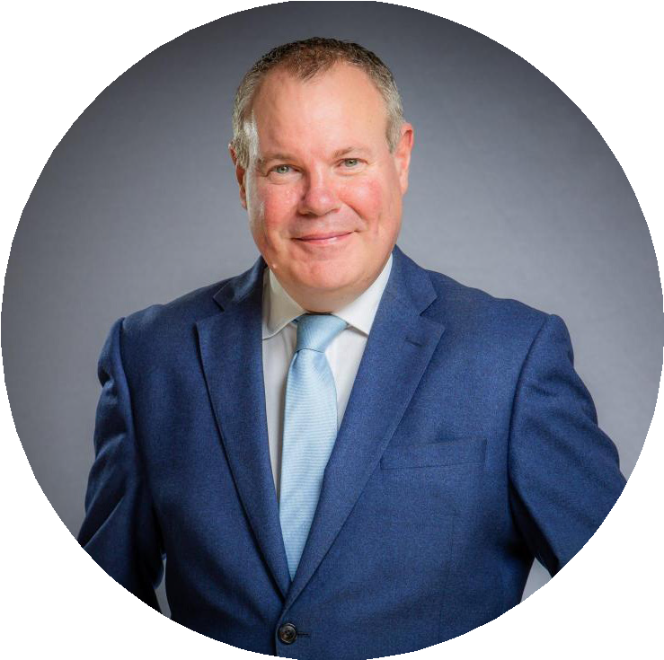
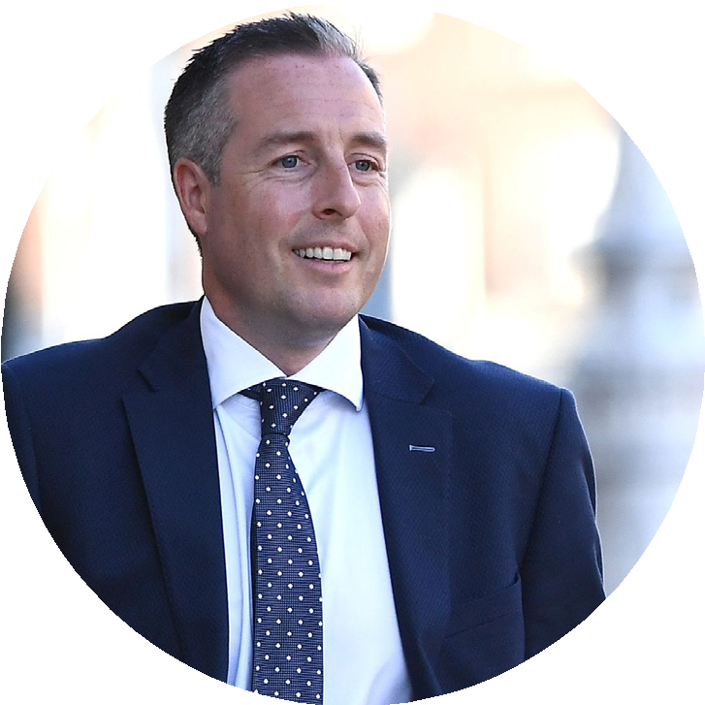
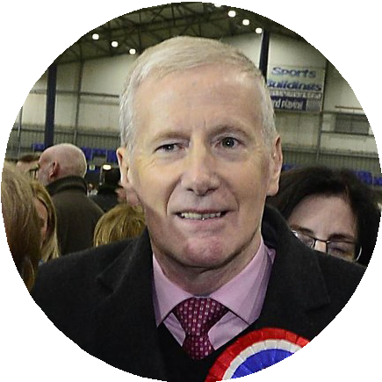
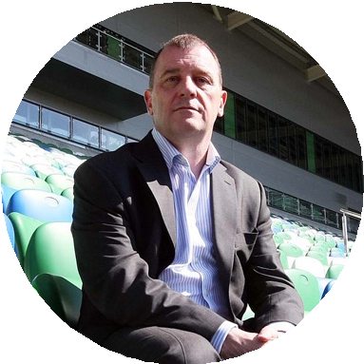
CONSULTEES
The Minister of State for Northern Ireland CONOR BURNS
First Minister
PAUL GIVAN
Department for Communities
MINISTER DEIRDRE HARGEY
MP for East Londonderry
GREGORY CAMPBELL
Department of Economy CHAIRPERSON CAOIMHE ARCHIBALD
All the local Members of the LOCAL ASSEMBLY
All the local
POLITICAL PARTIES
Irish Football Association,
CEO PATRICK NELSON
Local COMMUNITY, COMMERCIAL, EDUCATION
and public sector groups

Slide 7
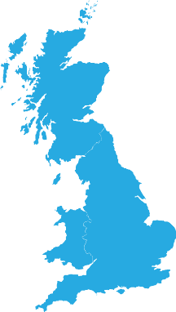
STRATEGIC FIT
UK GOVERNMENT
Net Zero Strategy: Build Back Greener 2021
CENTRAL GOVERNMENT
Northern Ireland Programme for Government 2016-2021
New Decade, New Approach Deal 2020
Children and Young People’s Strategy 2020-2030
A New Sport and Physical Activity Strategy for Northern Ireland (Consultation Document 2021
Building Inclusive Communities Strategy 2020-2025
Making life better
A whole system strategic framework for Public Health 2013-2023
Department of Education Business Plan 2021/22
Improving Health within Criminal Justice- A strategy and Action Plan 2019
Skills strategy for Norther Ireland Skills for a 10x economy.
LOCAL GOVERNMENT
CC&GBC Corporate strategy 2021-2025
A Better Future Together a Community Plan for CC&GBC 2017- 2030
Sport & leisure facilities strategies August 2015
Pitches Conditions Survey & Investment Strategy (April 2019)
Coleraine Town Centre Masterplan (May 2012)
STATUTORY AGENCIES & ARM LENGTH BODIES
Education Authority Interim Strategic Plan 2017-2027
Policing plan 2020-2025
NIHE Corporate Plan 2017/18 – 2020/21
Sport NI Draft Corporate Plan for Public Consultation 2020-2025
The Irish FA’s Five-Year Strategy 2022-2027
IRFU strategic Plan 2018-2023
A strategy for Ulster Boxing 2018-2022

Slide 8
INITIAL INVESTMENT MADE BY THE CLUB
4G PITCH AND IRRIGATION SYSTEM
CHANGING AND MEDICAL ROOMS
PUBLIC REALM (WALL AND CARPARK)
PUBLIC SAFETY ITEMS
£570,000
Funder: Coleraine Football Club’s own funds
£50,000
Funder: Supporter club fund raising
£80,000
Funder: Landfill Community Fund
£26,000
Funder: Sport NI
TOTAL INVESTMENT TO DATE £726,000

Slide 9
PROPOSED STADIUM INVESTMENT PLAN
DEMOLITION AND 8,000
CAPACITY STADIUM DEVELOPMENT
(Net Zero Carbon design)
COMMUNITY 3G TRAINING PITCH WITH
FLOODLIGHTING
PROFESSIONAL FEES
PROVISIONS
£12,670,000
£725,000 £1,415,000
TOTAL INVESTMENT PLAN £16,579,000
£1,769,000

Slide 10
BENEFITS REALISATION
Developing a North West Regional STADIUM AT THE SHOWGROUNDS WITH 3G COMMUNITY TRAINING
PITCH has the potential to attract INTERNATIONAL GAMES AND TRAINING CAMPS
to the area.
Modern facilities will encourage increasing attendance at games and ATTRACT
back MAJOR TOURNAMENTS
and events back to Coleraine.
The new facilities will provide 2,500 HOURS OF RECREATIONAL SPACE on 3G
surface in an urban area annually, which doesn’t exist for the local community and supported
by structured programmes.
Bring ECONOMIC BENEFIT to the club and the wider Coleraine town
(increase the existing
£5.53 MILLION SOCIAL RETURN on
Investment already achieved).
Enable INCREASED SUPPORT for vulnerable adults, prevent anti-social behaviour amongst young people and provide a sporting outlet from females and young with education and health & wellbeing PROGRAMMES.
Provide a MODERN FACELIFT and
public realm area to a highly deprived area STIMULATING REGENERATION.

Slide 11
#OurGoal #levellingupfund Thank you bobby.farren@colerainefc.com

